Slide 1
641 Form & Data Training

Slide 2
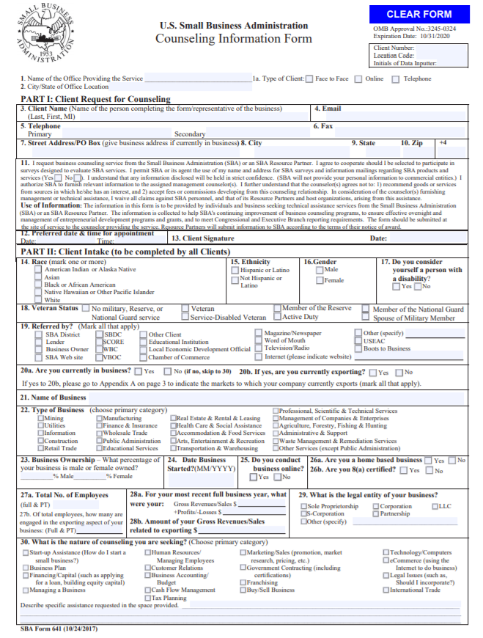
641 – Counseling Information Form
The 641 is designed to collect client specific data
It is recommended that all fields be as complete as possible
The more data completed, the more information both the SBA and the SBDC networks will have for trend analysis

Slide 3
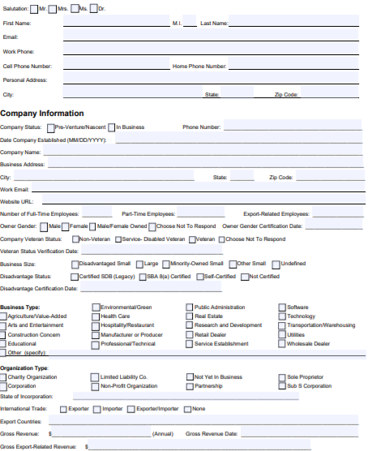
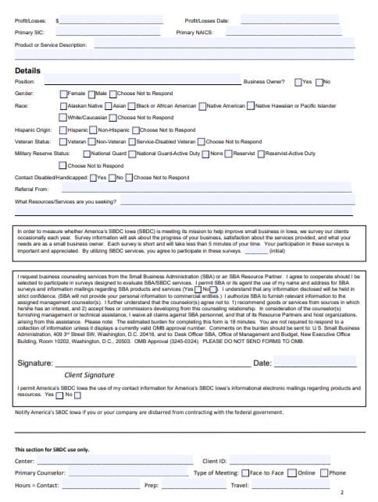
Custom 641/Intake forms
SBA Form
Custom State Form

Slide 4
Part I/SBA
Client Contact Data
Signature
* This is the difference as well between a counseling client and a training attendee

Slide 5
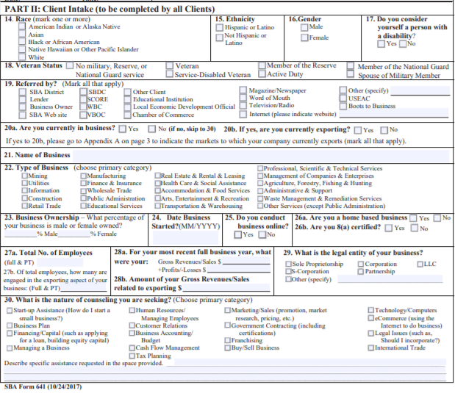
641 Part II
Demographic Data
Business & Impact Data
*Creates baseline

Slide 6
Required Fields
Mandatory
Part One – contact information and signature
Part Two
Race
Veteran
In business
Type of business
Business Ownership
Start date – if in business
Non-mandatory Fields (PA & EDMIS)
Employees
Gross sales
Export sales
Government contracting
Other economic impact data

Slide 7
641 Data Vs. Signature
Data Only
Used for capturing training attendee information to be used as a Unique Client.
Must reference Management training Report/888 for tracking purposes
Required fields must still be completed
Data fields – impact and other non required fields should be captured to help network with meeting other goals such as jobs supported.
Signature
Required for counseling clients

Slide 8
Questions?
Lisa Shimkat
lshimkat@iastate.edu
515-408-6370

